Slide 1
Abstract classes

Slide 2
Class base
{
Public:
void func1()//inheritance
{
Cout<<“base func1”<<endl;
}
Virtual void func2()//polymorphism
{
Cout<<“base func2”<<endl;
}
};
Class derived:public base
{
Public:
Void func2()
{
Cout<<“derived func 2”<<endl;
}
};

Slide 3
Class base//abstract class
{
Public:
void func1()//inheritance
{
Cout<<“base func1”<<endl;
}
Virtual void func2()=0;//polymorphism
};
Class derived:public base
{
Public:
Void func2()
{
Cout<<“derived func 2”<<endl;
}
};

Slide 4
Abstract Class is a class which contains atleast one Pure Virtual function in it. Abstract classes are used to provide an Interface for its sub classes. Classes inheriting an Abstract Class must provide definition to the pure virtual function, otherwise they will also become abstract class.

Slide 5
Characteristics of Abstract Class
Abstract class cannot be instantiated, but pointers and references of Abstract class type can be created.
Abstract class can have normal functions and variables along with a pure virtual function.
Abstract classes are mainly used for Upcasting, so that its derived classes can use its interface.
Classes inheriting an Abstract Class must implement all pure virtual functions, or else they will become Abstract too.

Slide 6
Why can't we create Object of an Abstract Class?
We can't create an object of abstract class because it has partial implementation of methods.

Slide 7
Pure Virtual definition
Pure Virtual functions can be given a small definition in the Abstract class, which you want all the derived classes to have. Still you cannot create object of Abstract class.
Also, the Pure Virtual function must be defined outside the class definition. If you will define it inside the class definition, complier will give an error. Inline pure virtual definition is Illegal.

Slide 8
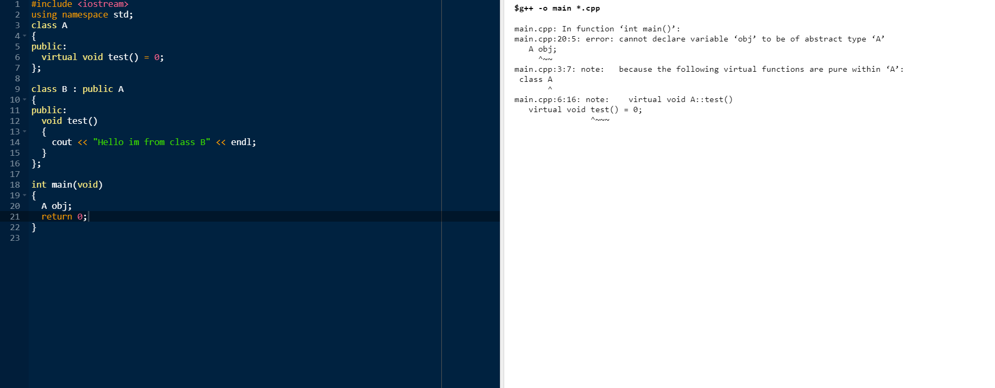

Slide 9
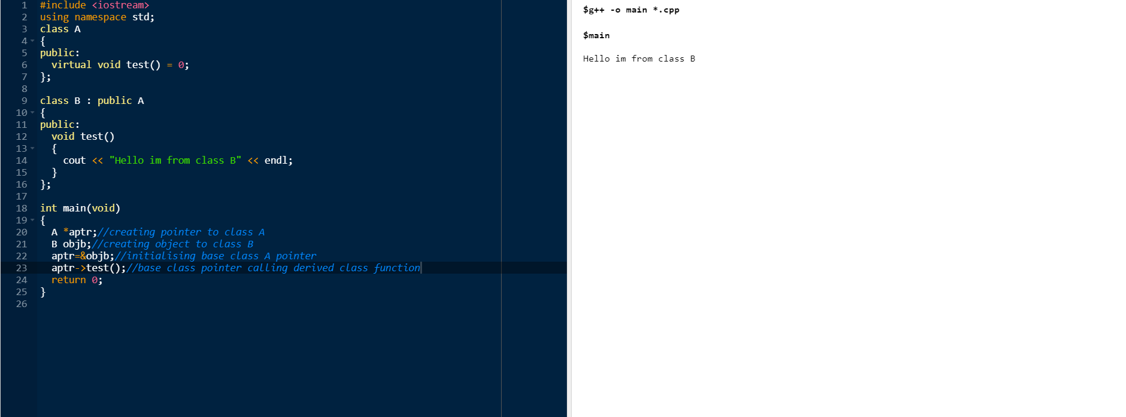

Slide 10
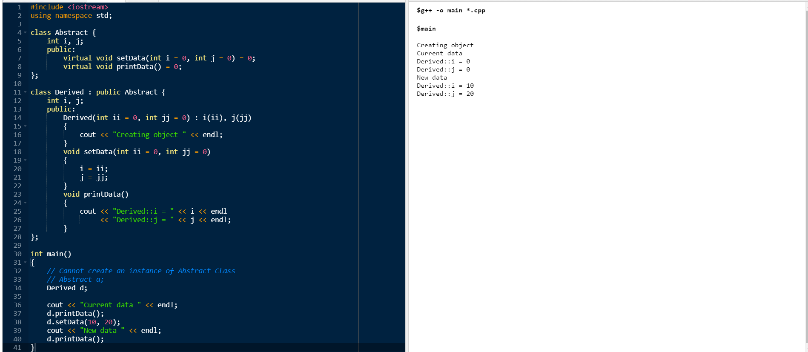

Slide 11
In cpp we can write 3 types of classes
Base class | Base class | Base class
All concrete functions | 1.Concrete functions 2.Some pure virtual functions | All pure virtual functions
All the functions are implemented they can be derived | Pure virtual functions must be implemented by derived classes | Pure virtual functions must be implemented by derived classes
Purpose-inheritance | Purpose-reusability &polymorphism | polymorphism
By inheritance we can do code reusability | Base class is also called as abstract class | Base class is also called as abstract class and also can be called as interface.but interface is not a keyword in cpp
 | We cannot create object to abstract class but we can create reference | We cannot create object to abstract class but we can create reference

Slide 12
Virtual destructor
Deleting a derived class object using a pointer to a base class that has a non-virtual destructor results in undefined behavior. To correct this situation, the base class should be defined with a virtual destructor.

Slide 13
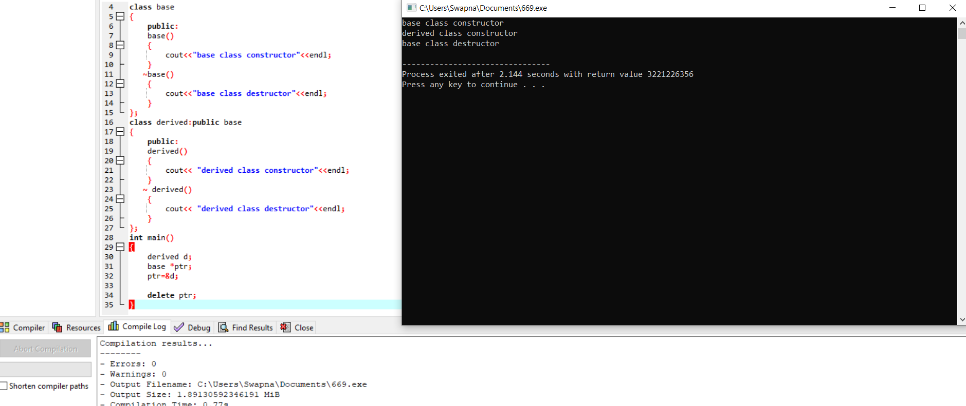

Slide 14
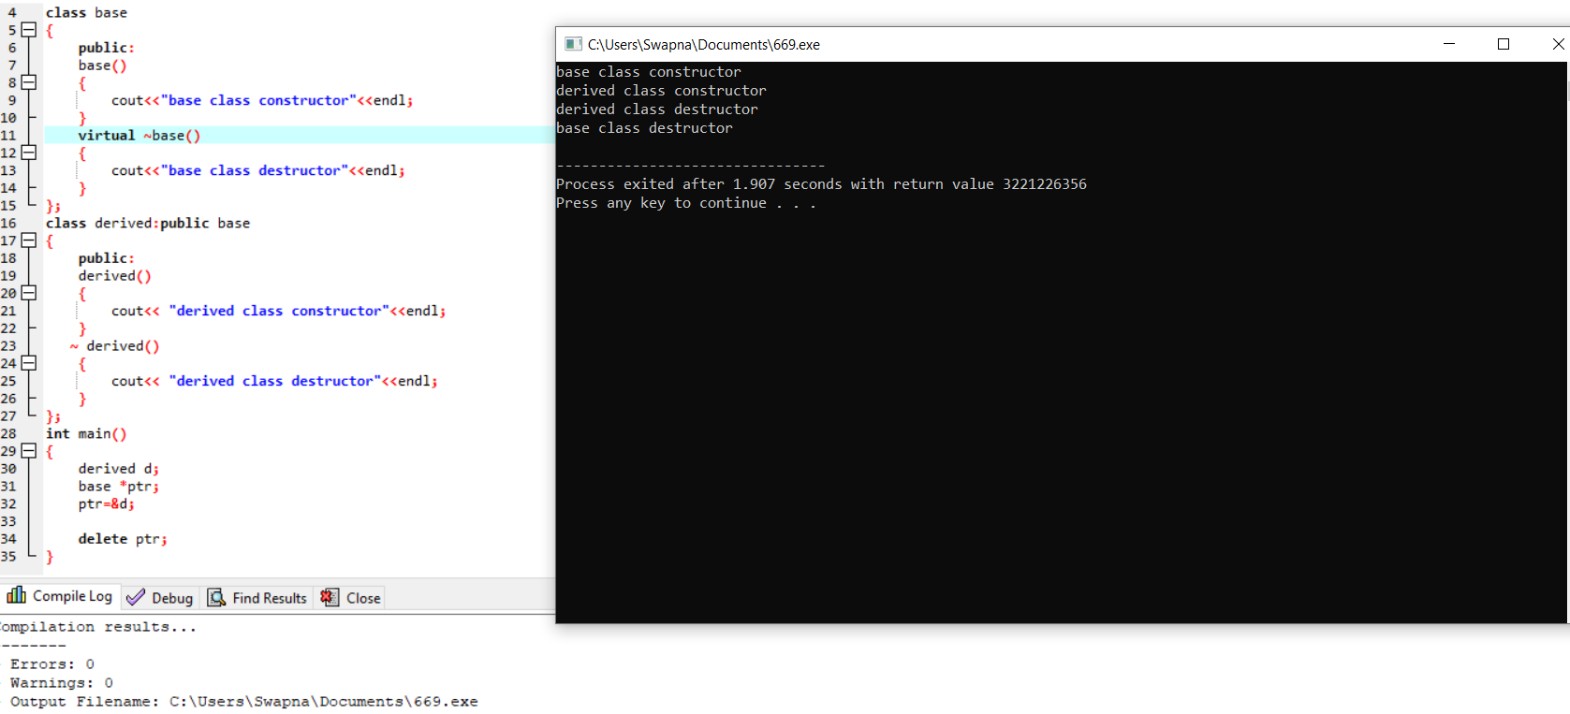

Slide 15
